Slide 1
Develop Language
Simple, Compound,
and Complex Sentences

Slide 2

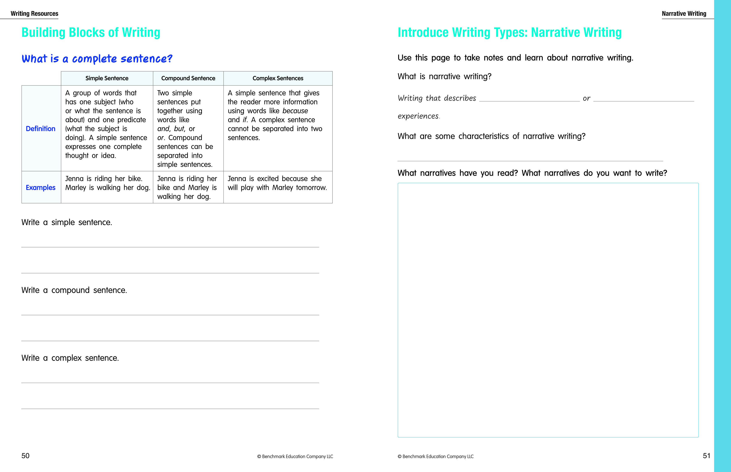
Collaborate
  Who/What is the subject of the first sentence?
  What is the predicate?
  Who/What is the subject of the second sentence?
  What is the predicate?
Simple Sentence
Learning Outcomes
  I will write simple, compound, and complex sentences.
    Teach
        Read aloud the definition of a simple sentence.
Notes:
Writing in Complete Sentences
Let's review complete sentences. Remember, writing in complete sentences helps you clearly share your ideas with your readers.
Simple Sentences
A simple sentence is a group of words that has both a subject, who or what the sentence is about, and a predicate, what the subject is doing. A simple sentence expresses one complete thought or idea.
Ask a student volunteer to read the first example sentence aloud.
What is the subject of the first sentence? Who or what is the sentence about? (Jenna)
What is the predicate? What is the subject doing? (is riding her bike)
Ask a student volunteer to read the second example sentence aloud.
What is the subject in the second sentence? What is the predicate?
Direct students to tell an elbow partner the subject (Marley) and predicate (is walking her dog) of the second sentence. Then, review the correct answers with the class. Be sure that students understand that this is a simple sentence.

Slide 3
Collaborate
  What are the two simple sentences in the example?
Compound Sentence
Learning Outcomes
  I will write simple, compound, and complex sentences.
Notes:
Compound Sentences
A compound sentence is written by putting two simple sentences together using words like and, but, or or. Compound sentences can be separated into simple sentences.
Ask a student volunteer to read the compound sentence example out loud.
What are the two simple sentences in this example? (The first simple sentence is Jenna is riding her bike. The second simple sentence is Marley is walking her dog.)

Slide 4
Collaborate
  What word links the two ideas?
  What are the two ideas?
Complex Sentence
Learning Outcomes
  I will write simple, compound, and complex sentences.
Notes:
Complex Sentences
A complex sentence is a simple sentence with additional information added to it. Complex sentences are created using words like because and if. A complex sentence cannot be separated into sentences that make sense on their own. In a complex sentence, the parts of the sentence depend on each other.
Ask a student volunteer to read aloud the complex sentence example.
What word links the two ideas in this complex sentence? (because)
What are the two ideas in the complex sentence? (Jenna is excited because she will play with Marley tomorrow.)
Elaborate that the first idea is a simple sentence that can stand alone, and the second idea adds more information but does not make sense if it is read without the first idea.

